Slide 1
VISUAL C#.NET session 12
Instructor: Edwin oduor

Slide 2

Quote of the day

Slide 3
Lesson objectives
OOP Principles
Class
Object
Illustration a class and Object
Pillars of OOP
Abstraction
Real Life Examples of Abstraction
Encapsulation
Inheritance
Types of Inheritance
Polymorphism
Access Modifiers

Slide 4
Lesson pre-requisites
In order to take full advantage of this section you need to have the following;
Computer with Visual Studio Installed.
Stable Network Connection.

Slide 5
Training methods and extra readings
TRAINING METHODS FOR THIS LESSON
EXTRA READINGS
Lecturing Method – This is the main method of training to be adopted in this lesson with illustrations and practical coding examples.
Discussion Method - This method will be adopted periodically whereby learning will be derived principally from the students brainstorming together, rather than from the trainer. Three main types of discussions will be used:
Directed discussion
Developmental discussion
Problem-Solving discussion
Home and Learn C#

Slide 6
OBJECT ORIENTED PROGRAMMING (OOP)

Slide 7
WHAT is OOP?

Slide 8
Object Oriented Programming. When talking about OOP this is a programming paradigm that relies on the concept of classes and objects. To understand OOP then we need to understand what class and objects are.

Slide 9
WHAT is A CLASS?

Slide 10
A class is a blue print of an object. To further explain this concept let’s take an architect when they want to build a house, they usually have the design of the house how it’s going to look like, that design is what they are going to use to come up with the actual house. The design that the architect use that is the blue print.

Slide 11
WHAT is AN OBJECT?

Slide 12
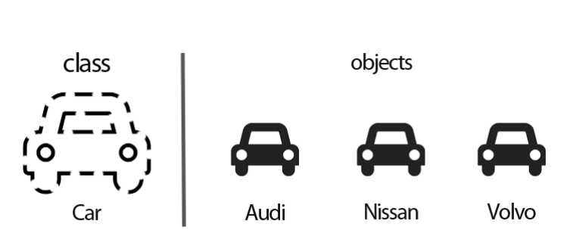
Object on the other hand is the instance of a class.
Let’s think of a class as a concept and the object as the representation of the concept.

Slide 13
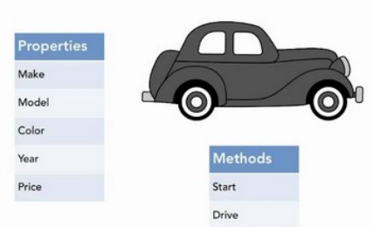
Real life objects have two characteristics namely: state and behavior. Let’s take the car that we had talked about earlier. The state of the car is Make, Model, Color while the behavior is start, drive etc.

Slide 14
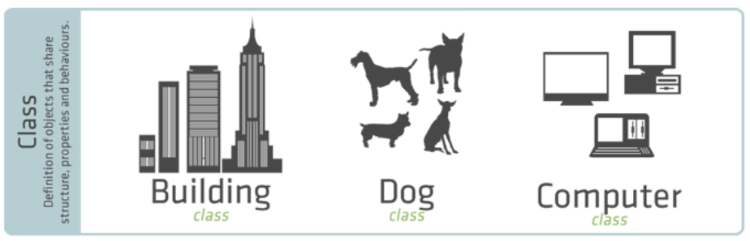
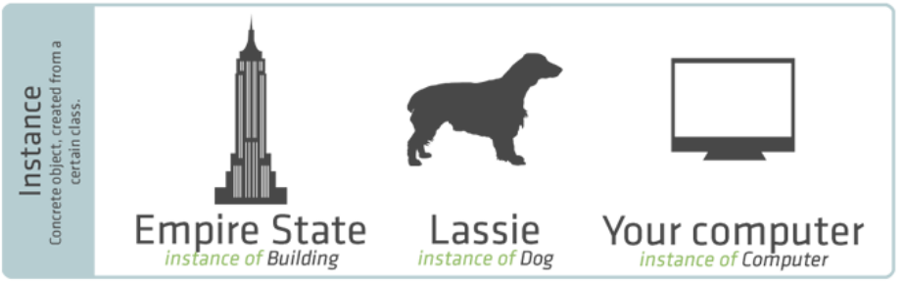
ILLUSTRATION OF CLASS & OBJECT

Slide 15
PILLARS OF OOP

Slide 16
Abstraction
Encapsulation
Inheritance
Polymorphism

Slide 17
1. ABSTRACTION
The concept of hiding the complexity from the users and only showing what is relevant to the users is known as abstraction.

Slide 18
REAL LIFE EXAMPLES OF ABSTRACTION

Slide 19
Most of us use lifts when in the buildings i.e. to move from one floor to another, we don’t really know how the lift operates but what normally happens is that inside the lifts there are buttons that one presses and they are taken from one floor to another, what the user is provided with are the buttons but we don’t know how the lift move from one floor to another. This is abstraction.
Most if not all of us use phones to make calls or send message we are provided for GUI (Graphical User Interface) for the users to use, hence we just go ahead and make or send message to various people but we don’t understand how the message get delivered, this is also abstraction.
Users uses ATM to do transactions but don’t really understand how the ATM machine works.

Slide 20
2. encapsulation
Before defining what encapsulation is let’s first take this scenario, I believe we all know what a capsule is, A capsule has content inside of it, the contents of the capsules are protected by the outer covering of the capsules. The same concept happens when talking about Encapsulation this is wrapping up of data and methods in a single unit. The components of a class are protected through this concept whereby they are encapsulated hence they are protected from access outside the class, this is achieved through the use of private key word.

Slide 21
3. INHERITANCE
When a child is born there are some features that the kid is going to inherit from the parents for instance the child can inherit the height, complexion, behavior as they grow up just to mention a few. The same concept applies in programming when creating a class, we will have a base class (parent) and the Derived Class (child), the base class will have properties and methods when a child class is created the child will be able to have all the properties that the base class have and all the methods as well, this is what is known as inheritance.

Slide 22
TYPES OF INHERITANCE

Slide 23
Single Inheritance
Hierarchical Inheritance
Multi-level Inheritance

Slide 24
A. SINGLE INHERITANCE
CLASS A (base class)
CLASS B (derived class)

Slide 25
B. HIERARCHICAL INHERITANCE
CLASS A (base class)
CLASS B: A (derived class)
CLASS C: A (derived class)

Slide 26
C. MULTI-LEVEL INHERITANCE
CLASS A (base class)
CLASS B: A (derived class)
CLASS C: B (derived class)

Slide 27
4. POLYMORPHISM
This is the ability of an object to take many forms.
Perform certain action in different ways.

Slide 28
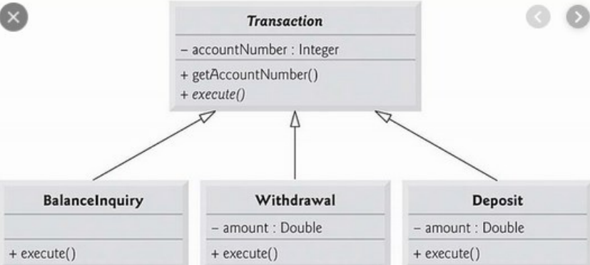
EXAMPLE OF POLYMORPHISM

